Slide 1
Presence of Opioids in Wastewater
Drew Gobbi, Olivia Wang, Olatunji Akinbule, Maddie Warndorf
Measurement

Slide 2
Question, Hypothesis, Key Construct and the Relationships
Question: Are low income individuals, who are middle aged, more prone to opioid use?
Hypothesis: People in the selected areas who have low incomes and who are middle aged are more prone to higher opioid use.
Key Constructs Related to the Hypothesis:
opioid use
people with low income
people who are middle aged
Proposed Relationship:
The construct of people with low income is correlational to the construct of opioid use
The construct of people who are middle aged is correlational to the construct of opioid use.
Notes:
Maddie

Slide 3
Construct/Feature Table
Construct | Feature(s)
Opioid Usage | Population Normalized Mass Load (mg/day/1000 capita) Number of Opioid Related EMS Calls
Low Income
Middle Age
 | Sample_Date Call Date
 | Site Code (TP02, TP04, TP05) Geometry (Geographic Polygon) Geometry (Geographic Point)
 | Chemical Name
List of Features
Wastewater Pilot Data: Site Code (TP02, TP04, TP05), Chemical Name, Sample_Date, Population Normalized Mass Load (mg/day/1000 capita), Geometry (Geographic Polygon)
Opioid EMS Call Pilot Data: Call Date, Geometry (Geographic Point), Number of Opioid Related EMS Calls
Notes:
Maddie

Slide 4
Plans to Measure the Constructs that are Missing Features
Construct of People with Low Income:
Measure people with low income with people whose household incomes are below federal poverty level
Measure people with low income with people whose incomes are in the lowest 10% of household income in Tempe
Construct of People who are middle-aged:
Measure people who are middle-aged with people whose ages fall within the 45-65 age range
Notes:
Olivia

Slide 5
Nominal, Ordinal, Interval or Ratio?
Proposed Constructs
Based on features that we want to extract from census data:
We want the percentage of the population whose incomes are within the low income level to be a ratio because the percentage of the population whose incomes are within the low income level does have an absolute zero.
We want the percentage of the population whose age is within middle age range to be ratio also because the percentage of the population whose age is within middle age range does have an absolute zero.
Features Without Constructs
Site code, Geometry (Geographic Polygon), and Geometry (Geographic Point) are nominal.
Chemical name is nominal.
Since we are assuming that time is independent, we assume that time intervals do not impact our estimates. Therefore, we expect this feature to be nominal.
Existing Construct
Based on the opioid usage construct, we want the features Population Normalized Mass Load (PNML) and Number of Opioid Related EMS Calls to be ratio because they both have an absolute zero.
Notes:
Olivia

Slide 6
Face and Content Validity of Opioid Use Measures
Population Normalized Mass Load (PNML)
Face valid - people who use opioids go to the bathroom. It seems reasonable that the drugs will show up in wastewater, and that we could extrapolate the number of users from an average dosage
Content valid - likely to be unbiased (you can’t hide the number), measured with scientific rigor, objective and in controlled way, measured consistently
EMS Calls
Face Valid - the number of emergency calls for drug overdoses gives an indicator of how many people are using drugs
Content Valid (harder to establish) - measured by healthcare professionals, but also measured under stress, represents direct detection of drug use but could miss users who don’t go to the hospital
Notes:
Face Validity: Does it pass the “giggle test”?
Content Validity: Define a checklist for what a good measure looks like, and adopt a measure that does
Wastewater is collected periodically over 24 hours and transferred to a lab where researchers extract and prepare the sample for a technique (liquid chromatography tandem mass spectrometry), a process that measures the levels of chemicals in the wastewater sample.

Slide 7
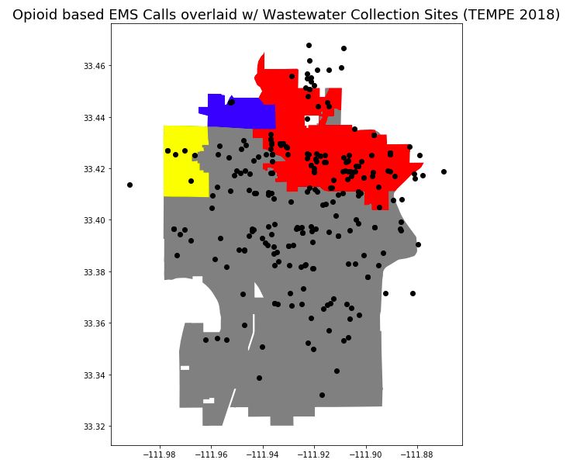
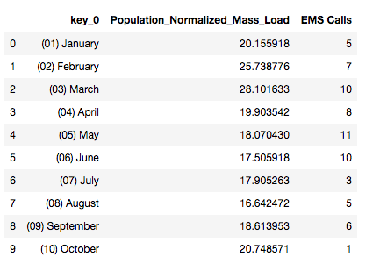
Convergent/Discriminant Validity between PNML and EMS Measures of Opiate Use
However you measure it, we expect different indicators of drug use to have a positive relationship with one another. Looking at collection area two (area with greatest overlap in pilot data) to compare
Notes:
DREW

Slide 8
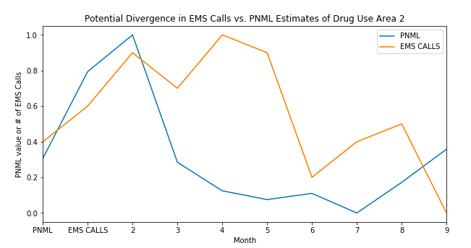

Discriminant Validity between PNML and EMS Measures of Opiate Use (cont.)
Relationship between the features doesn’t converge completely. We hypothesize that this is because the EMS calls have a detection bias that understates the true number of drug users
Notes:
DREW

Slide 9
Measurement Error of Features
PNML - researchers include a mass load error measure in the dataset that represents a quantifiable margin of error for each sample
EMS Calls - hard to quantify. Could potentially reconcile with EMS responses to overdoses recorded in hospitals or accompanying police calls. Our best guess at how to handle this is through establishing the consistency of the measure
Features Extracted from the Census (ex. Income, Age) - American Community Survey (ACS) publishes variance estimates for the features it collects, along with sample methodology and weights
Notes:
DREW

Slide 10
Sources of Methodological Bias
Number of Opioid Related EMS Calls: Caller reported indications on drug related incidents might be missed on an EMS call
Call Date, Sample_Date: We expect time dependent noise in high frequency observations. We address this issue by aggregating our data points up to monthly measures or lower our frequency samples. Estimates are shown to be time stationary at the monthly level. Therefore we don’t anticipate methodological bias introduced by time dependency.
Notes:
TJ
Time dependency - measurements of PNML between days will likely exhibit intra-time correlation (meaning they are not IID). However, we assume that this time dependency will be averaged out over longer time periods (i.e. weeks, months, etc.). Testing at a monthly level, we find that observations of monthly averages are independent of one another based on time (via autocorrelation function and an augmented dickey fuller test - I can talk to this if asked but don’t bring this up unless you are asked).

Slide 11
Measures of Reliability for Construct/Feature Pairs
Construct of Opioid Use:
Reliable across space and time (test-retest reliability)
Continuous variable
we don’t expect strong correlations between EMS and PNML data within each area
However, we do expect samples taken from different collection areas within each measure to be performing consistently over time (because time independent)
Construct of People who are Middle-Aged:
No measures of reliability because no other ways to define age
Construct of People with Low Income:
internal consistency
Continuous variable
Assign each Area/Site as an item and within each item, look at how different measures (Percentage of people/households whose incomes are below federal poverty level & Percentage of people/households whose incomes are within the lowest 10% of all household incomes in Tempe) correlate.
Notes:
Olivia

Slide 12
Threats to Construct Validity
The PNML is the primary indicator for opioid usage in each of the three sites and is potentially prone to the mono-operation bias.
Resolution: Incorporating the number of opioid related EMS calls from the EMS calls data to comparatively estimate the opioid usage
Fluctuation in daily opioid concentrations dependent on the amount of water and total mass drug inputs.
Resolution: We anticipate short term spikes or dips in PNML concentration - however our focus is on long term trends in interpreting our construct, opioid usage using the PNML.
Notes:
TJ
Construct validity: The extent to which our measures correspond with the features
Monotone: You use one measure for your construct and assume that is the right one

Slide 13
Ethical Concerns
The analysis is performed on community-aggregated and anonymized data points to understand drug use patterns. This allows for an anonymous analysis that can identify opportunities to improve treatment risk and factors. Consequently, we do not anticipate any ethical concerns with the study.
Notes:
Maddie

Slide 14
Questions?

